Slide 1
NUCLEATION -
FROM MOLECULAR CLUSTERS
TO NANOPARTICLES
Paul Wagner
Fakultät für Physik
Universität Wien
Austria

Slide 2
AEROSOL
Reasonably stable suspension of solid / liquid particles in a gas

Slide 3
Particle formation by gas to liquid phase transitions in supersaturated vapours
Nucleation (results in molecular clusters)
Homogeneous
Heterogeneous
Growth by condensation (results in aerosol particles)
Coagulation of particles (dynamic changes of aerosols)

Slide 4
PARTICLE FORMATION
IN THE ATMOSPHERE

Slide 5
CHARACTERIZATION OF
VAPOUR SUPERSATURATION
Saturation ratio:
p_{v} : Actual vapour pressure
p_{S}(T): Saturation vapour pressure
at temperature T

Slide 6
FREE ENERGY OF
CLUSTER FORMATION

Slide 7
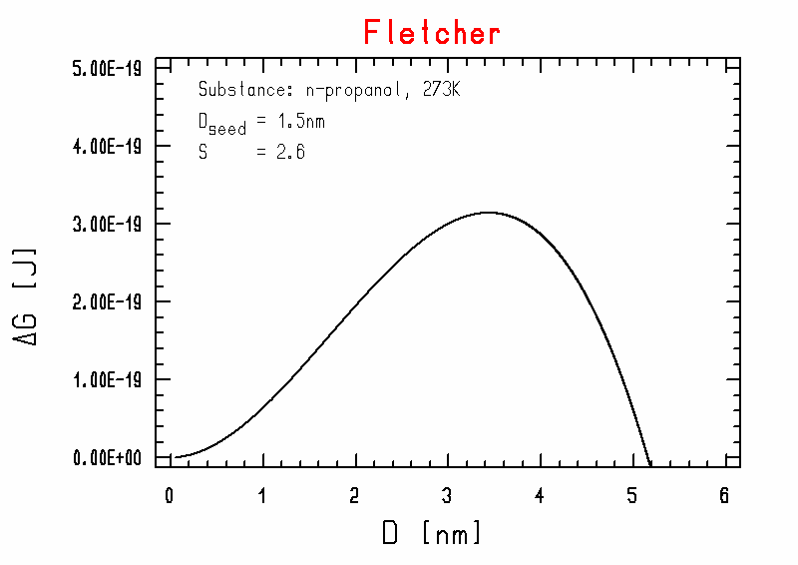
Free energy of cluster formation for neutral clusters

Slide 8
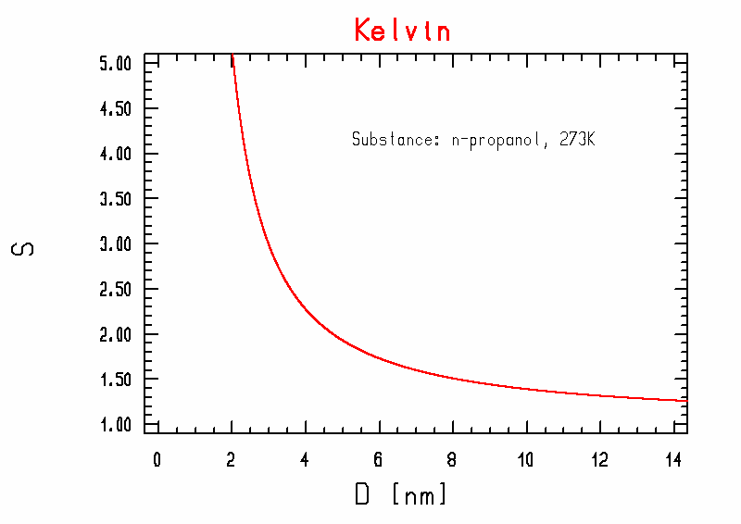
KELVIN - CURVE

Slide 9
Vapor-liquid equilibrium conditions over curved surfaces
Neutral particles: Kelvin equation

Slide 10
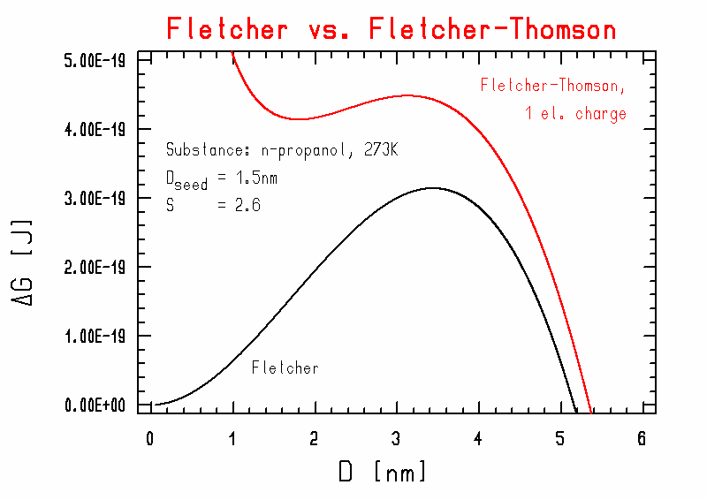
Free energy of formation of charged clusters

Slide 11
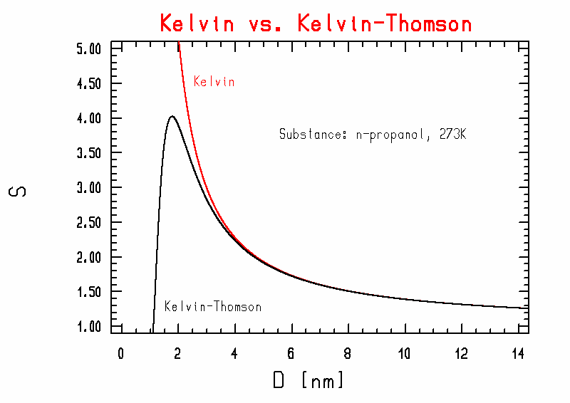
KELVIN – THOMSON - CURVE

Slide 12
Vapor-liquid equilibrium conditions over curved surfaces
Charged particles: Kelvin-Thomson equation

Slide 13
Particle growth by condensation
Mass flux I
vapor molecule
Heat flux Q
carrier gas molecule

Slide 14
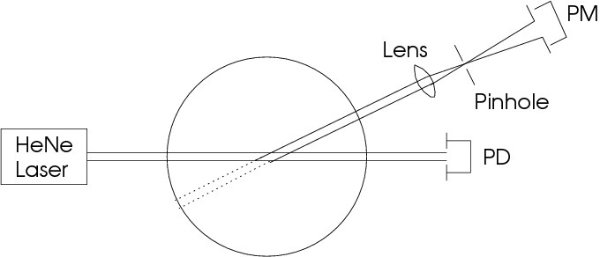
Detection of growing particles:
The Vienna expansion chamber system
Constant-Angle Mie Scattering (CAMS) method

Slide 15
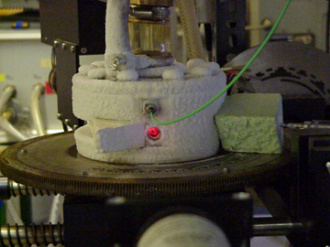

Slide 16
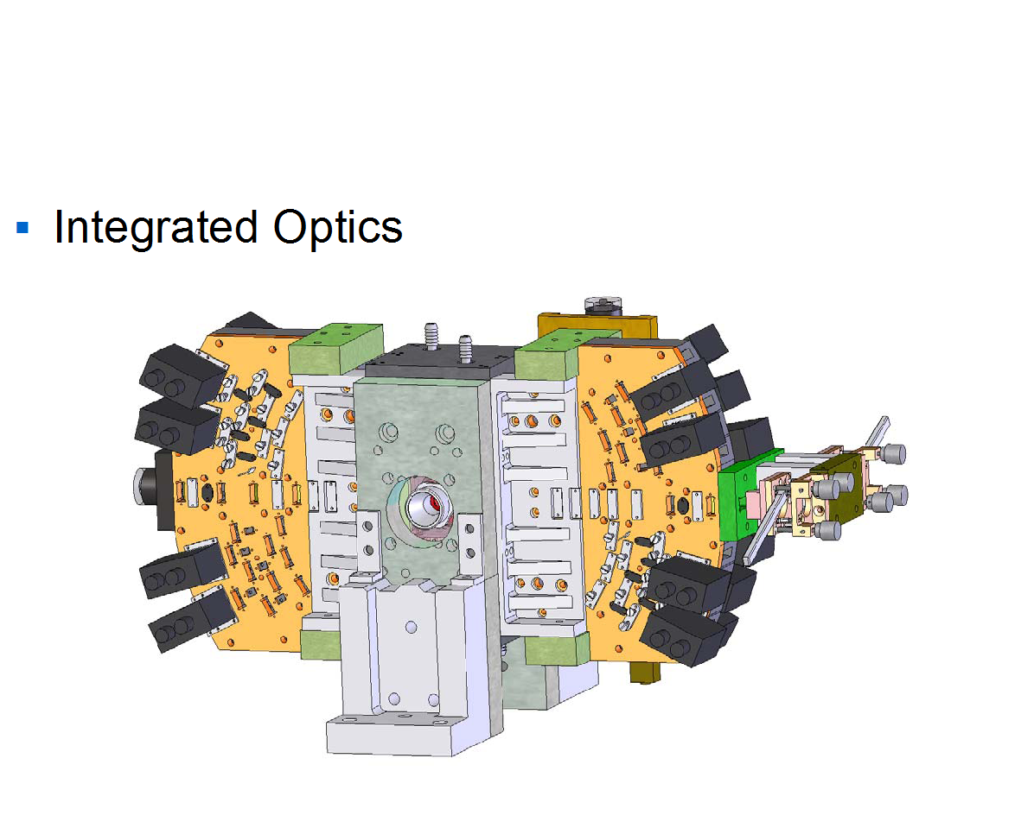

Slide 17
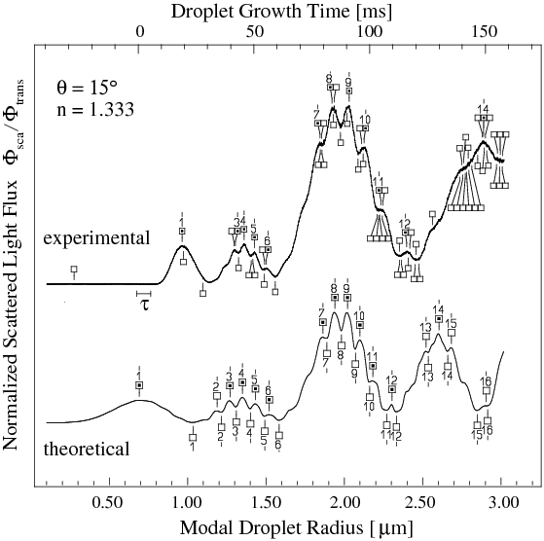
Experimental and theoretical normalized scattered light fluxes at 15°

Slide 18
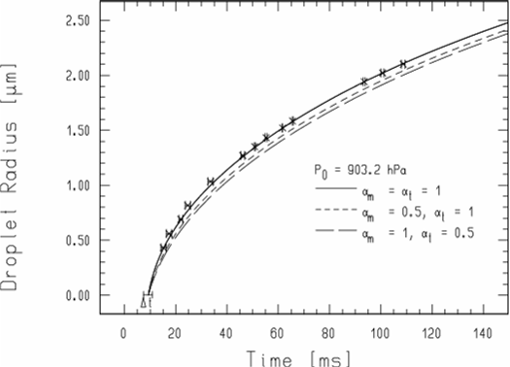
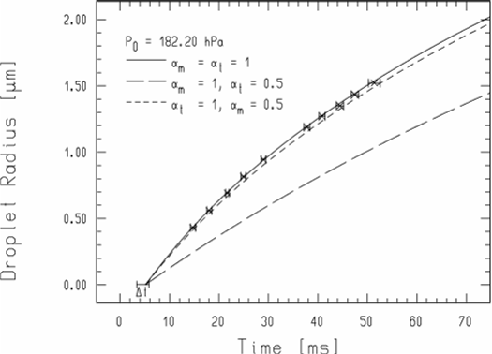
Variation of α_{m} and α_{t} for water at different system pressures

Slide 19
Thermal accommodation coefficient α_{t} for water
Winkler, Vrtala, Wagner, Kulmala, Lehtinen, Vesala, Phys. Rev. Lett. 93, 075701 (2004)

Slide 20
Mass accommodation coefficient α_{m} for water
Winkler, Vrtala, Rudolf, Wagner, Riipinen, Vesala, Lehtinen, Viisanen, Kulmala, J. Geophys. Res. 111, D19202 (2006)

Slide 21
CONCLUSIONS
ACCOMMODATION COEFFICIENTS
FOR WATER
α_{t} > 0.85 for all studied conditions
α_{m} > 0.8 between 250 and 270K
α_{m} > 0.4 between 270 and 290K
All data consistent with α_{t} = α_{m} = 1
No significant temperature dependence

Slide 22
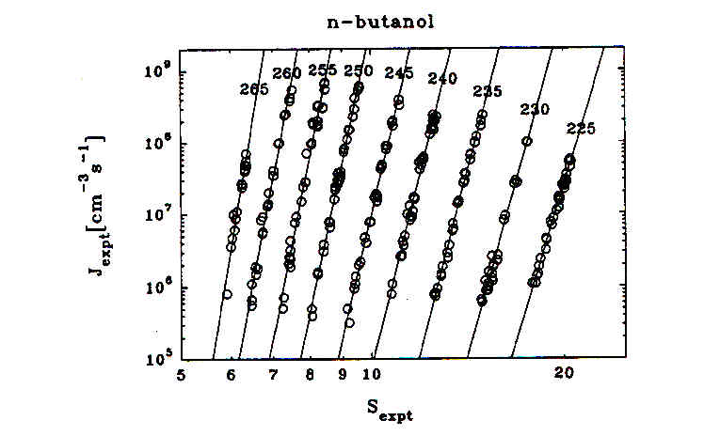
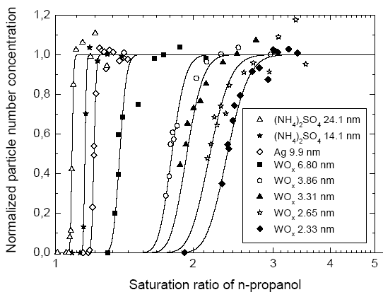
NUCLEATION OBSERVABLES
Homog. nucleation:
Observable J
Parameter T [K]
Heterog. nucleation:
Observable P
Parameter D_{seed} [nm]

Slide 23




(First) NUCLEATION THEOREM
Homog. nucleation
Kashchiev (1982)
Heterog. nucleation
Vehkamäki et al. (2007)

Slide 24
HETEROGENEOUS NUCLEATION THEOREM

Slide 25
Homog. nucleation in butanol vapour:
Linear fit

Slide 26
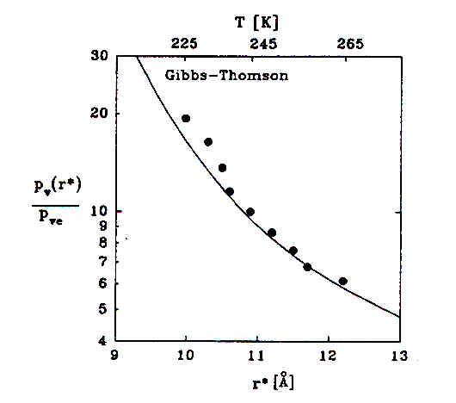
Application of Homog. Nucleation Theorem:
Test of Kelvin-Equation
Strey, Wagner, Viisanen, J. Phys. Chem. 98, 7748 (1994)

Slide 27
UNARY
HETEROGENEOUS NUCLEATION

Slide 28
Heterogeneous nucleation on charged and uncharged nanoparticles:
Bridging the scale from molecules to nanoparticles
Winkler, Steiner, Vrtala, Vehkamäki, Noppel, Lehtinen,
Reischl, Wagner, Kulmala, Science 319, 1374 (2008)

Slide 29
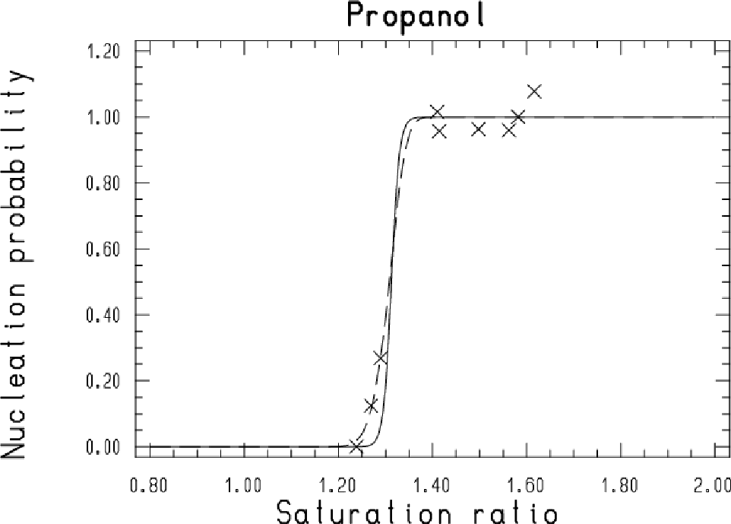
Application of Het. Nucl. Theorem on exp. heterog. nucleation data (Fletcher)
Problem:
Finite width of seed-particle size distribution

Slide 30
Measurements with single molecules:
Tetra-Heptyl-Ammoniumbromid
Electrospray:
THpA⁺ Ion D_{p} = 1.44 nm
THpABr⁺ Ion D_{p} = 1.67 nm
mono-molecular σ_{g} ~ 1.0
Vapour: n-Propanol
Evaluation:
Tanh-Fit
PCHNP-Fit with consistent slope

Slide 31
UNARY
HETEROGENEOUS NUCLEATION

Slide 32

Application of Het. Nucl. Theorem: Calculation of critical cluster size
Assumptions:
  Contact angle = 0
  (completely wettable)
  Assumption of spherical particles with
  macroscopic properties
  (despite of small number of molecules)

Slide 33
Size comparison

Slide 34
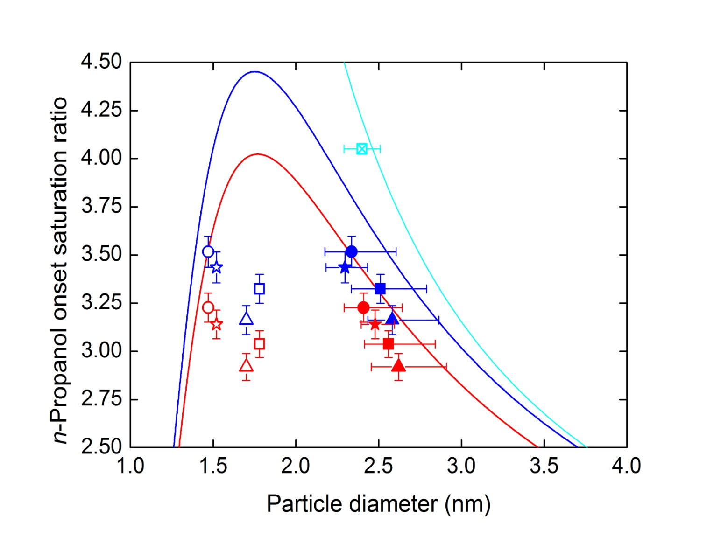
Comparison of exp. heterog. nucleation data to Kelvin-Thomson-equation
Winkler, Vrtala, Steiner, Wimmer, Vehkamäki, Lehtinen, Reischl, Kulmala, Wagner, Phys. Rev. Lett. 108, 085701 (2012)

Slide 35
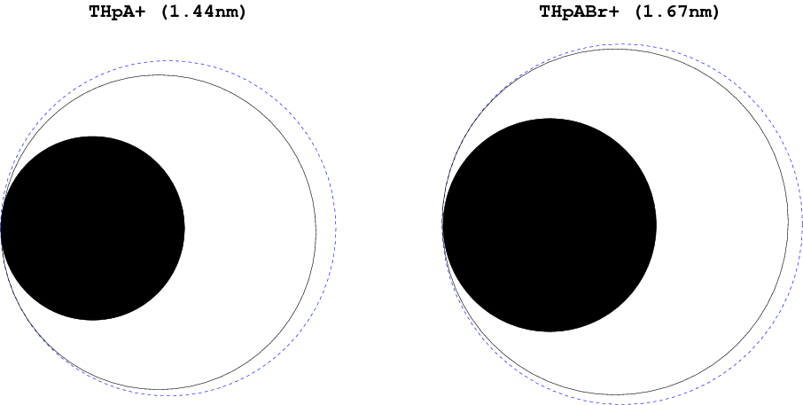
Size comparison
Blue broken line: Kelvin-Thomson

Slide 36
CONCLUSIONS
For nucleation we found a continuous transition from nanoparticles to single molecules
Nucleation on particles was observed already significantly below the Kelvin-Thomson diameter (important for operation of CPCs)
Satisfactory agreement of the diameter of critical clusters with Kelvin-Thomson-equation
Electrical charge on particles can enhance the heterogeneous nucleation process

Slide 37
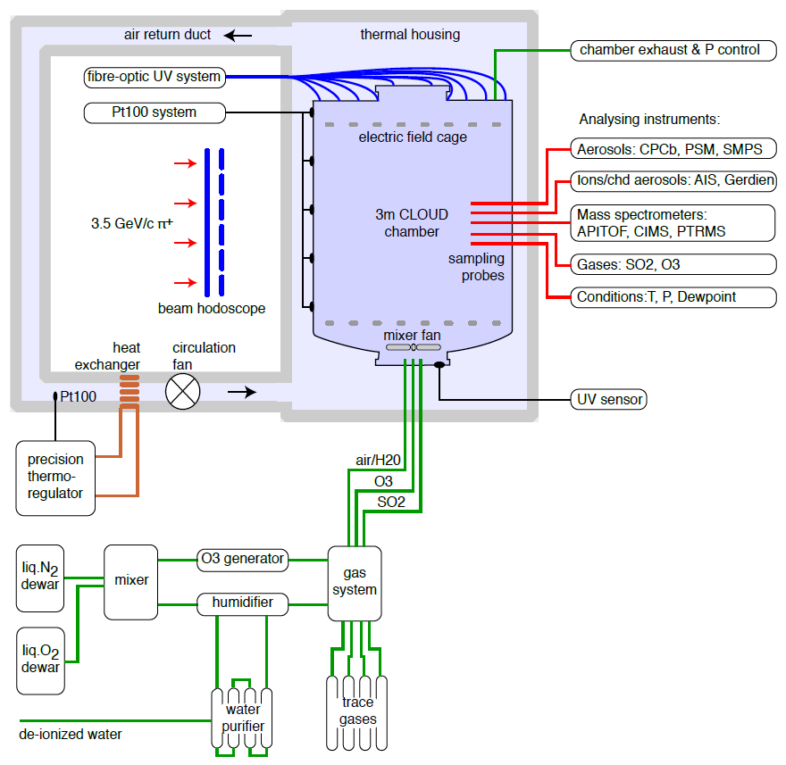
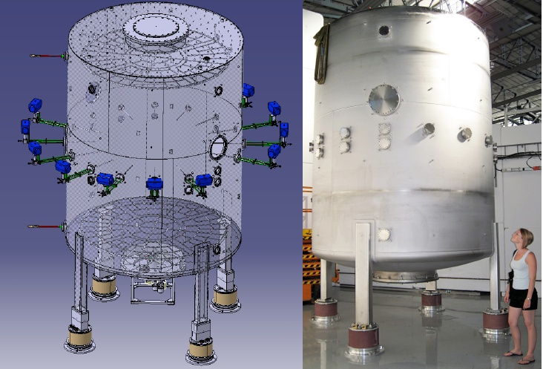
CLOUD Experiment: CLOUD Chamber at CERN

Slide 38
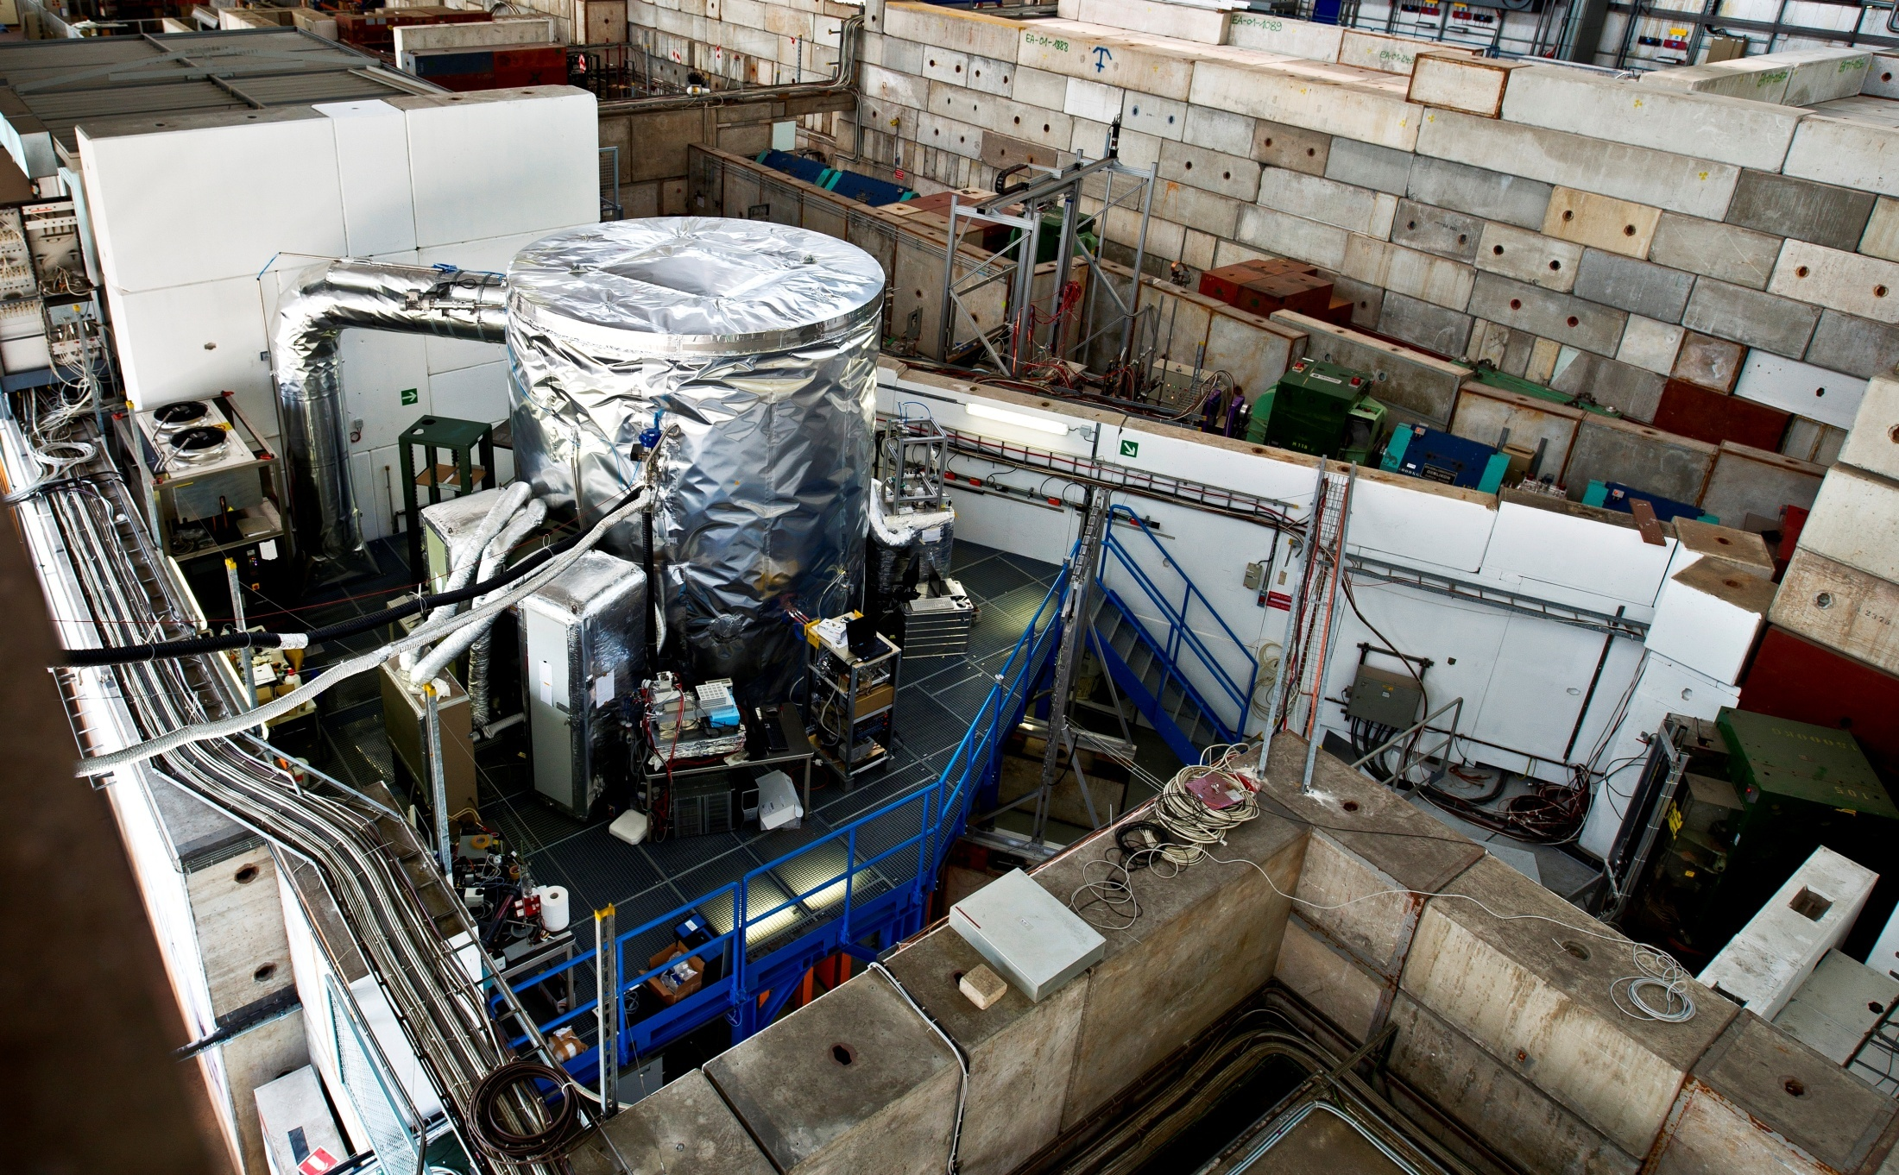
CLOUD Experiment: CLOUD Chamber at CERN

Slide 39
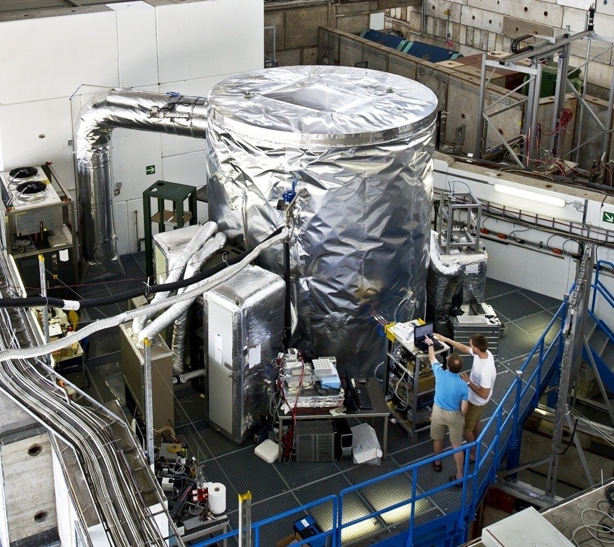
CLOUD Experiment: CLOUD Chamber at CERN
26.1 m³, stainless steel (electropolished)
3m diameter, 3.4m height
excellent thermal stability (±0.005°C), no change when UV on, temperatures down to -25°C

Slide 40
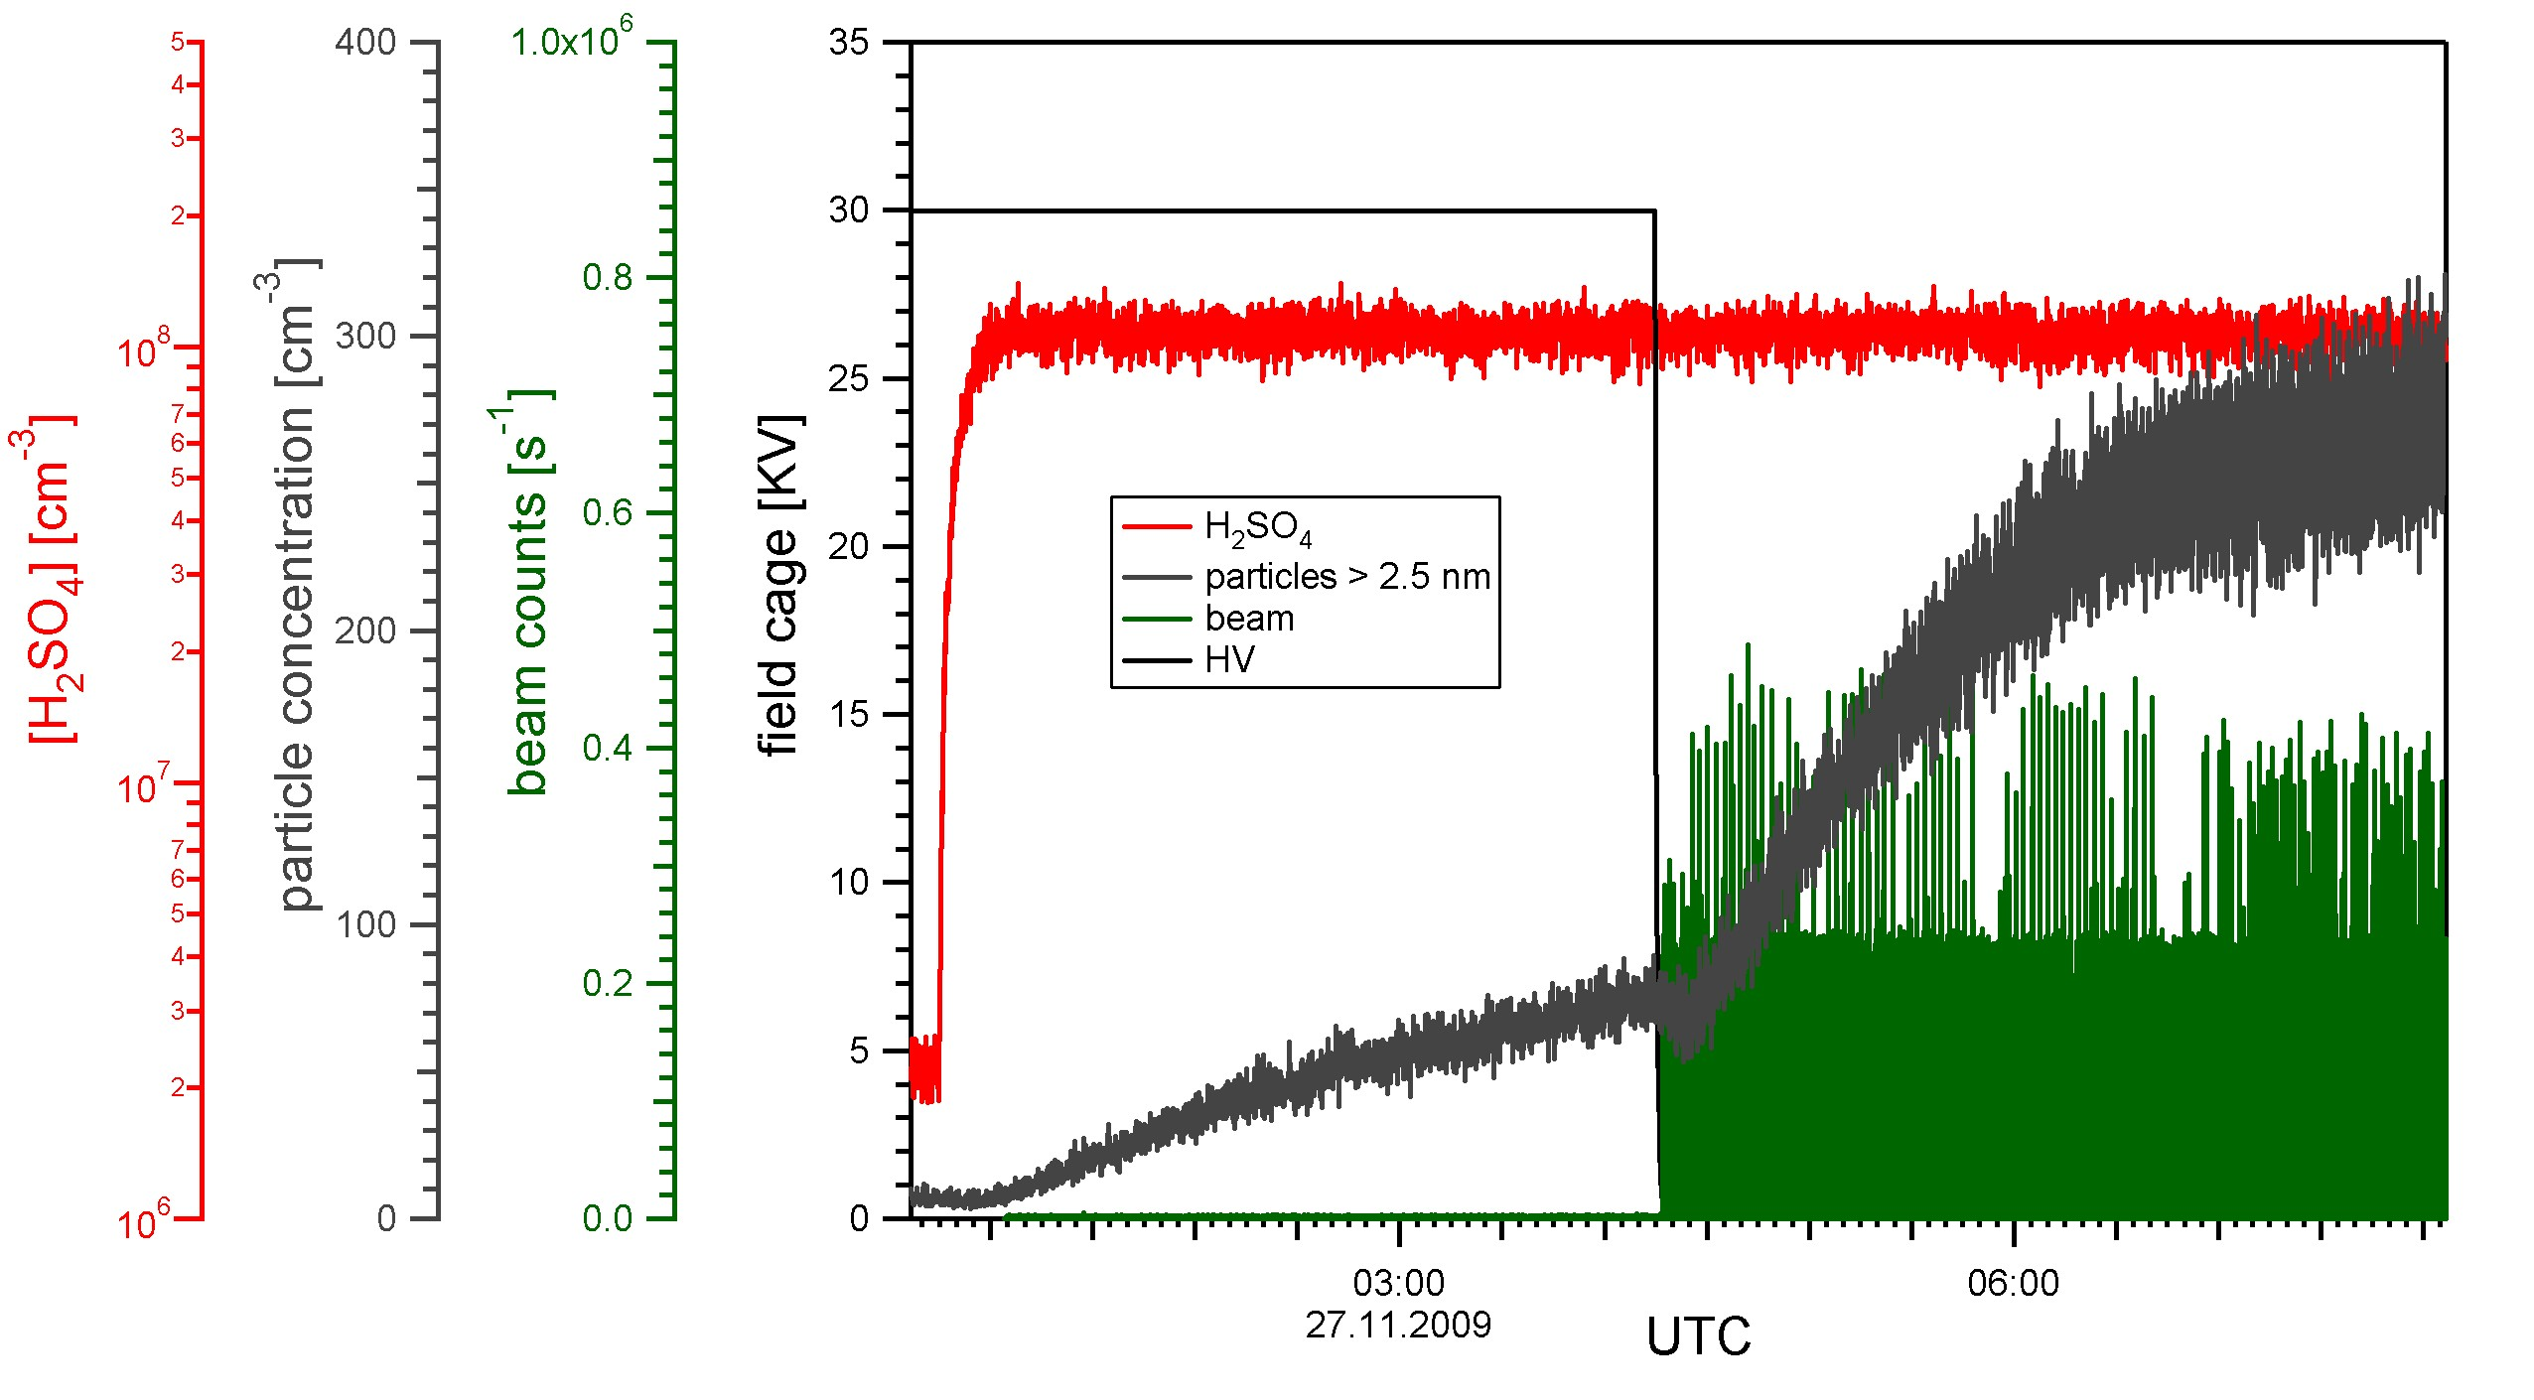
Event example: neutral vs. charged nucleation
neutral
charged
switching to charged nucleation
Nucleation rate: J = dN/dt
Increased nucleation rate due to ions

Slide 41
J vs. [H2SO4] comparison with PARNUC model
Kirkby et al., Nature 476, 429 (2011)

Slide 42
Comparison of CLOUD results with literature

Slide 43
CONCLUSIONS
Binary water/sulfuric acid nucleation
- is negligible within boundary layer
- can occur in free troposphere
Additional species are required to explain atmospheric nucleation rates
(ammonia, amines, etc.)
Ion enhancement of nucleation occurs for all temperatures observed so far: Potential link between galactic cosmic rays and clouds

Slide 44
Sponsors
Austrian Science Fund
(Project Numbers P19546, L593)
CLOUD-ITN, Marie Curie Action
EU Seventh Framework Programme
(Grant Number 215072)

Slide 46
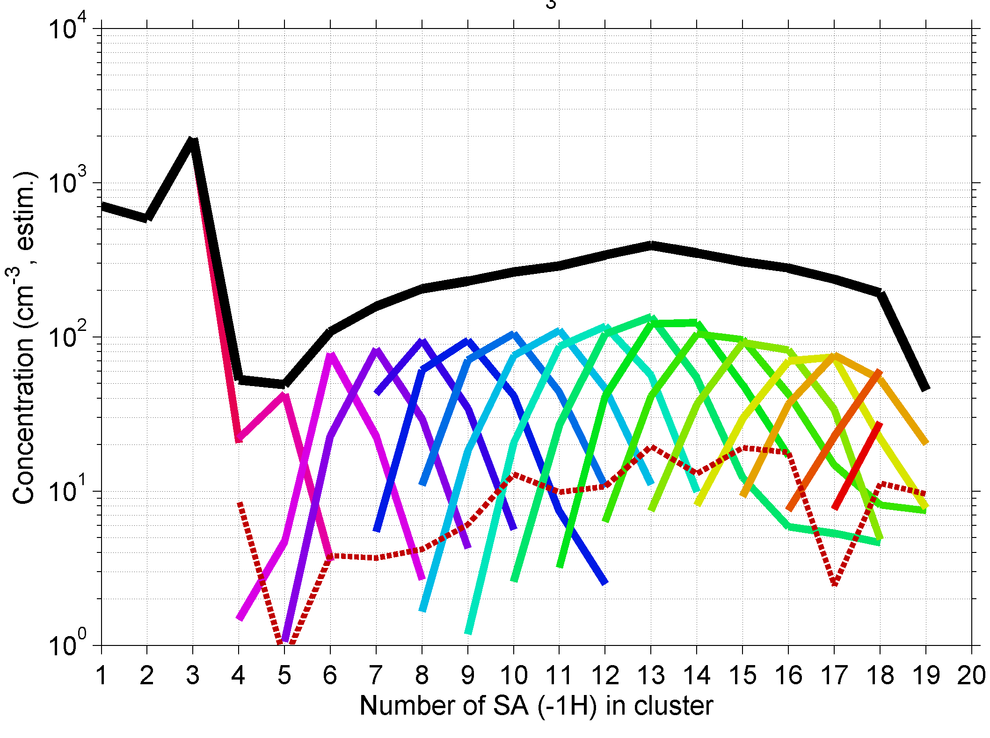
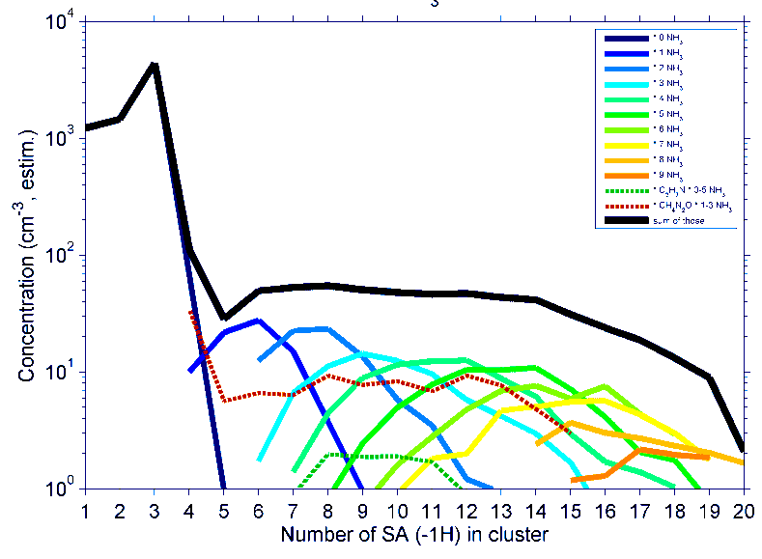
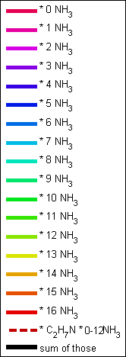
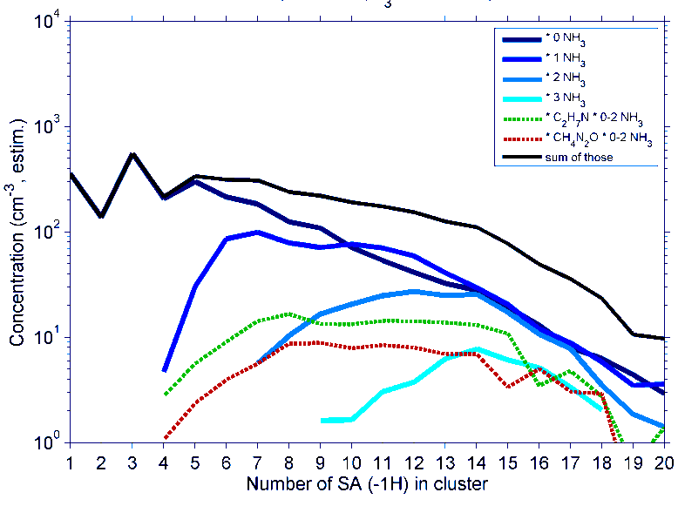
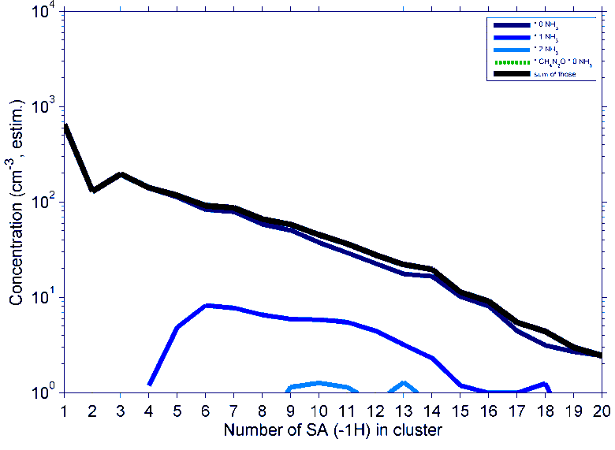
T = 20 °C
+400 ppt NH₃
T = 20 °C
T = 5 °C
Decrease in temperature,
constant [H₂SO₄]
T = -25 °C

Slide 47
stabilization mechanism

Slide 48
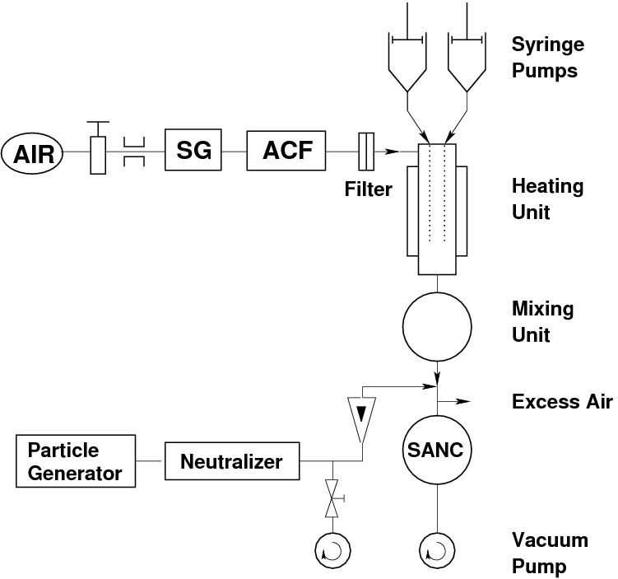
EXPERIMENTS ON
HETEROGENEOUS NUCLEATION

Slide 49
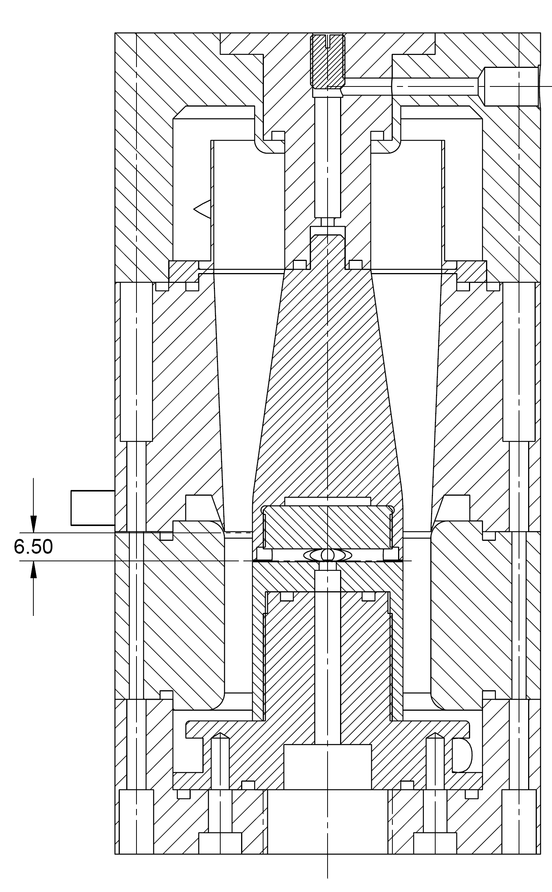
UDMA 2006
Sheath Air Input
Center Electrode
Channel Length 6.50 mm
Q_{a} = 3.95 l/min
Aerosol Input
Q_{sh} = 288 l/min
τ = 1ms
Anular Exit Slit
Excess Air Outlet
Q_{a}/Q_{sh} = 3.95/288 = 0.01
Sample Air

Slide 50
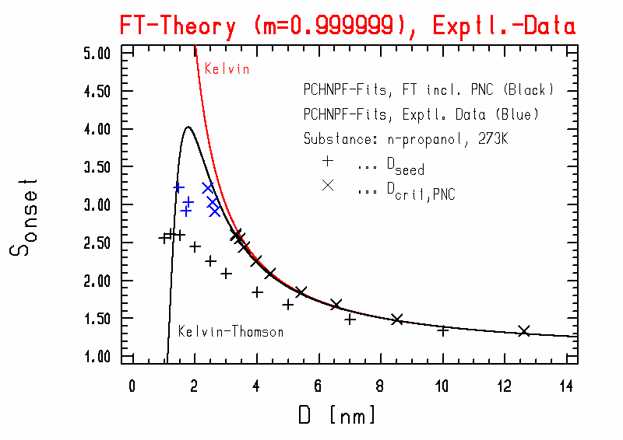
Comparison of exp. heterog. nucleation data to
Fletcher-theory and Kelvin-Thomson-equation

Slide 51
Size comparison:
Accounting for Stable Prenucl. Clusters

Slide 52
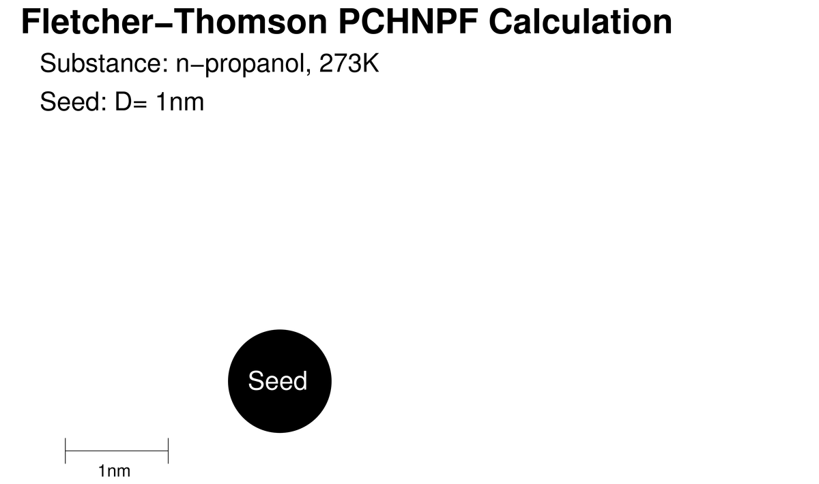

Slide 53
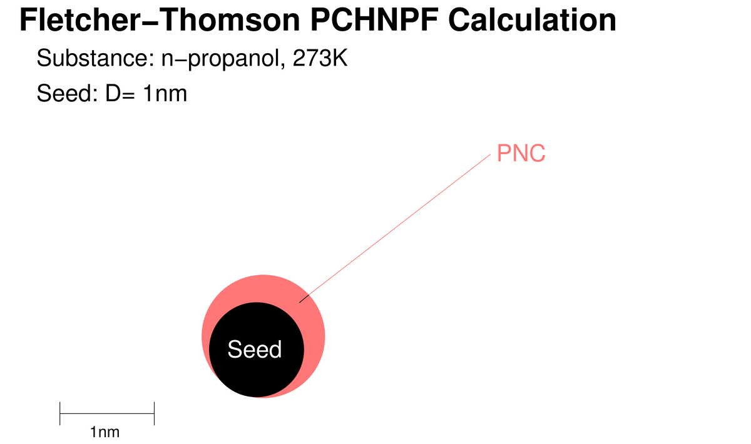

Slide 54
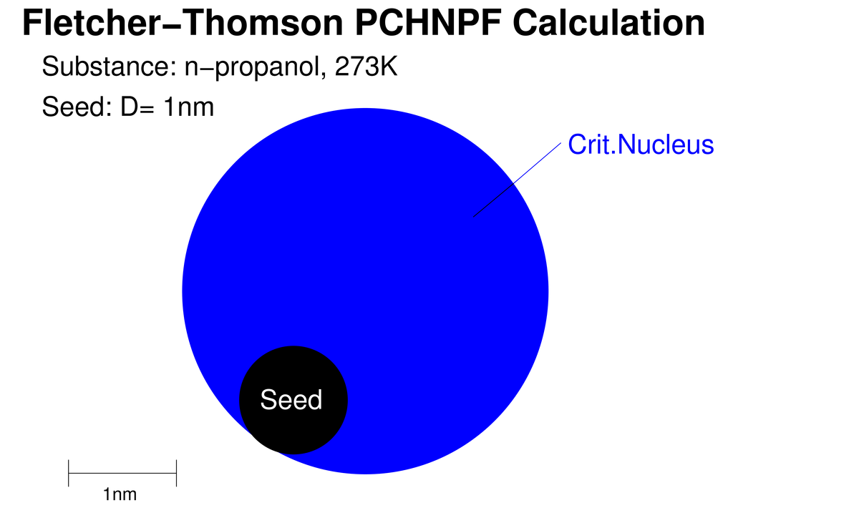

Slide 55
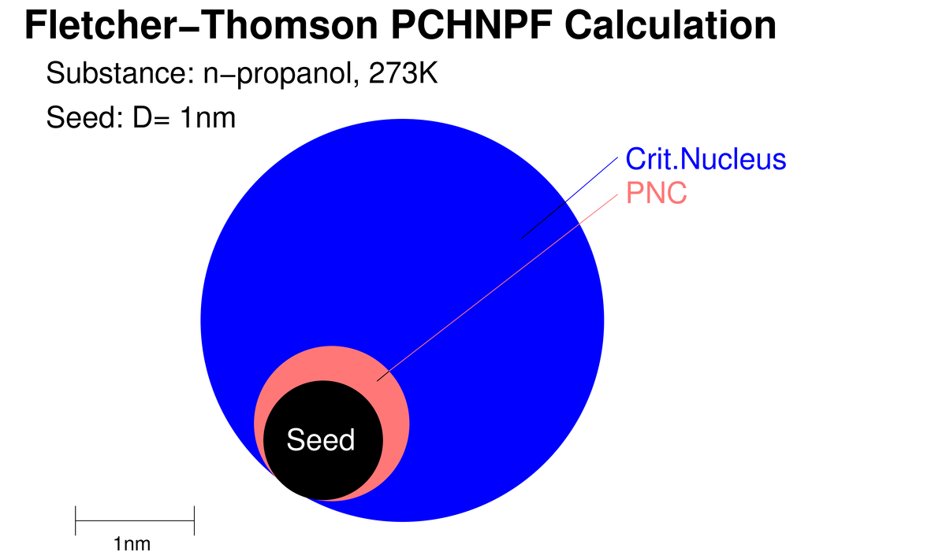

Slide 56
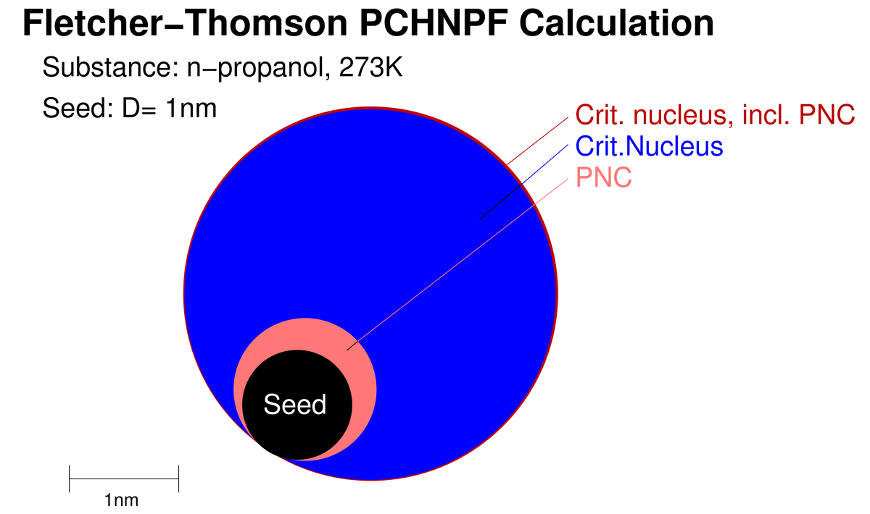

Slide 57
EXPRESSION FOR NUCLEATION RATE AND PROBABILITY

Slide 58
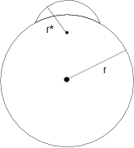
HETEROGENEOUS NUCLEATION THEORY Fletcher, J. Chem. Phys. 29, 572 (1958)

Slide 59
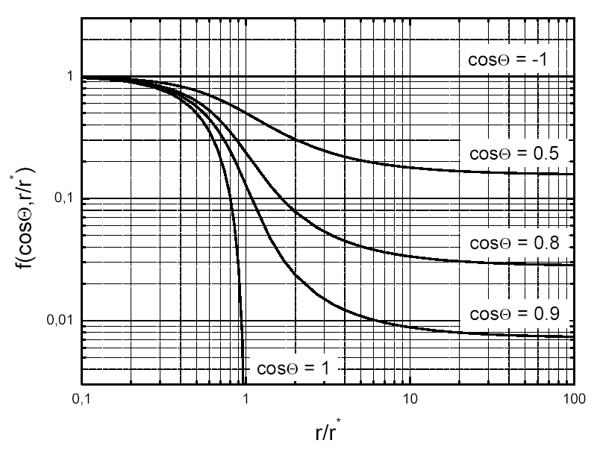
HETEROGENEOUS NUCLEATION THEORY
Reduction of energy barrier

Slide 60
Theoretical description of mass and heat flux
Total transitional mass flux:
Total transitional heat flux:

Slide 61
Transitional correction factors

Slide 62
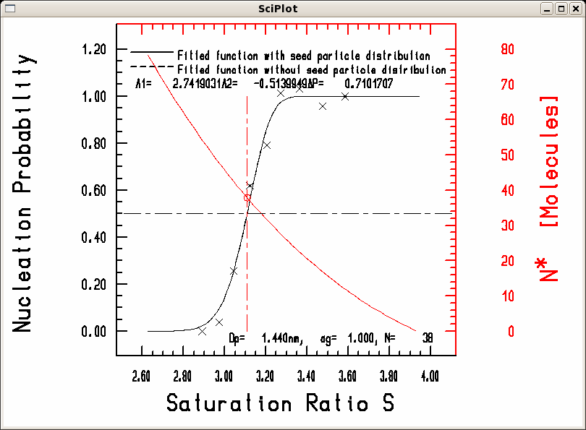
PCHNP-fit to exp. het. nucleation data, D_{p} = 1.44 nm

