Slide 1


How to ascertain uncertainties
The Full Bayesian Evaluation Technique for nuclear data application
VERA Diskussionsrunde, 18. Jänner 11
D. Neudecker, St. Gundacker, H. Leeb, Th. Srdinko, V. Wildpaner
Work partly supported by the ANDES and IP_EUROTRANS projects integrated in EURATOM. The computational results have been achieved in part using the Vienna Scientific Cluster.

Slide 2
Nuclear Data: merging experimental and theoretical data for nuclear applications.
Nuclear Data Evaluation
Theory
Exper-iment
Design of new facilities
Bench-marking
Sensitivity
New Technology
t
Bayesian Parameter Model Experimental
Statistics Uncertainties Defects Uncertainties

Slide 3
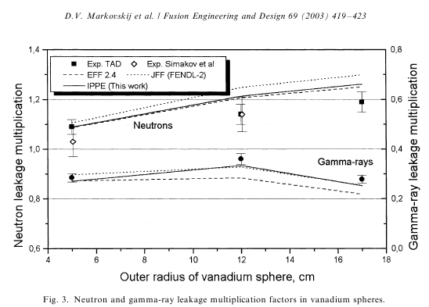
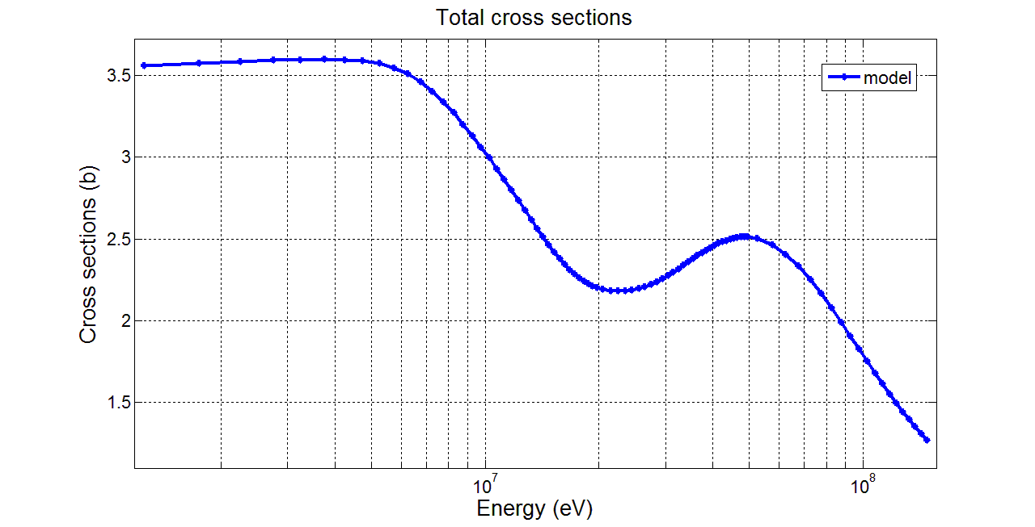
Nuclear Data: merging experimental and theoretical data for nuclear applications.
Nuclear Data Evaluat-ion
Theory
Exper-iment
Kalman
Backward-Forward Monte Carlo
Straight-forward MC sampling
Generalized Least Square (GANDR)
Bayesian Statistics (GLUCS)
…
Design of new facilities
Bench-marking
Sensitivity
New Technology
Fusion
ADS
GenIV
t
Bayesian Parameter Model Experimental
Statistics Uncertainties Defects Uncertainties

Slide 4
New technologies require extension of evaluation energy range and covariances.
Demands of new technologies
To combine exp. and model cross sections σ_{i} consistently up to
150 MeV.
To give associated
uncertainties in form of covariance matrices for whole energy range.
Bayesian Parameter Model Experimental
Statistics Uncertainties Defects Uncertainties

Slide 5
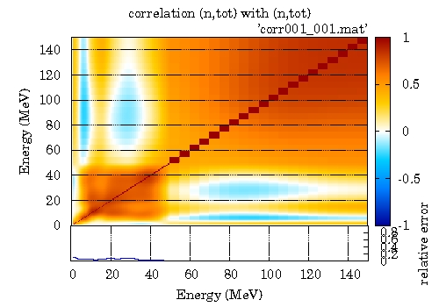
Covariance matrices measure the linear
dependence of two values.
Formal definition of covariance matrix
σ
Correlation matrix
E
Bayesian Parameter Model Experimental
Statistics Uncertainties Defects Uncertainties

Slide 6
The Full Bayesian Evaluation Technique is implemented in the program GENEUS.
GENEUS
GEneral Nuclear data Evaluation and Uncertainty System
Nuclear
Model
Parameter Uncertainties
Model
Defects
Experimental Cross Sections
Linearized
Bayesian
Update
Experiment Covariance Estimation
ENDF
Output
Bayesian Parameter Model Experimental
Statistics Uncertainties Defects Uncertainties

Slide 7
The Full Bayesian Evaluation Technique is based on Bayesian Statistics.
2 fundamental principles of Statistics:
x … model cross sections
M … model
σ … experimental cross sections
Normalization Condition
Product Rule
BAYES THEOREM
Likelihood function
Measures the prob. that σ is measured if x and M are correct.
Prior distribution
Measures the prob. to obtain the correct model cross sections x if M is true.
Bayesian Parameter Model Experimental
Statistics Uncertainties Defects Uncertainties

Slide 8
A Gaussian distribution is assumed for the prior distribution and the likelihood function.
BAYES THEOREM
Likelihood function
Prior distribution
Assumption: normal distribution of x around x₀ and σ around y(x)
In exponential form
Bayesian Parameter Model Experimental
Statistics Uncertainties Defects Uncertainties

Slide 9
Exp., model and par. uncertainties must be considered in the posterior probab. distr.
BAYES THEOREM in Gaussian form
Assumption: normal distribution of x around x₀ and σ around y(x)
x₀ around x normally distributed, if considering
Parameter Uncertainties
A₀^{PU}
Bayesian Parameter Model Experimental
Statistics Uncertainties Defects Uncertainties

Slide 10
Exp., model and par. uncertainties must be considered in the posterior probab. distr.
BAYES THEOREM in Gaussian form
Assumption: normal distribution of x around x₀ and σ around y(x)
σ around y(x) normally distributed, if considering
x₀ around x normally distributed, if considering
Model Defects
A₀^{MD}
Bayesian Parameter Model Experimental
Statistics Uncertainties Defects Uncertainties

Slide 11
Exp., model and par. uncertainties must be considered in the posterior probab. distr.
BAYES THEOREM in Gaussian form
Assumption: normal distribution of x around x₀ and σ around y(x)
σ around y(x) normally distributed, if considering
Uncertainties of experiment
B
Bayesian Parameter Model Experimental
Statistics Uncertainties Defects Uncertainties

Slide 12
Exp., model and par. uncertainties must be considered in the posterior probab. distr.
BAYES THEOREM in Gaussian form
Assumption: normal distribution of x around x₀ and σ around y(x)
σ around y(x) normally distributed, if considering
x₀ around x normally distributed, if considering
Uncertainties of experiment Model Defects Parameter Uncertainties
B A₀^{MD} A₀^{PU}
Bayesian Parameter Model Experimental
Statistics Uncertainties Defects Uncertainties

Slide 13
In Geneus, the linearized version of
Bayes theorem is implemented.
In Geneus, the linearized version of Bayes theorem is implemented
Every update step corresponds to the inclusion of one large experimental block covariance matrix B.
Bayesian Parameter Model Experimental
Statistics Uncertainties Defects Uncertainties

Slide 14
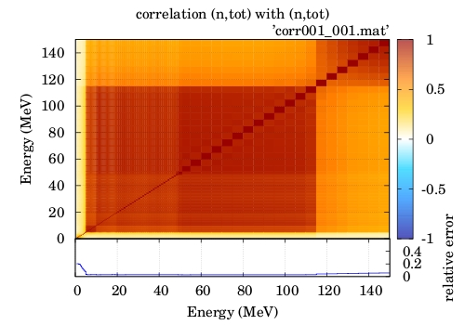
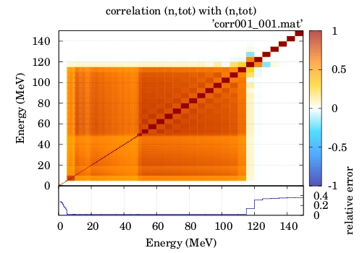
The Full Bayesian Evaluation Technique can ‘predict‘ experimental data consistently.
Eval. with full prior
Eval. with diagonal prior
Bayesian Parameter Model Experimental
Statistics Uncertainties Defects Uncertainties

Slide 15
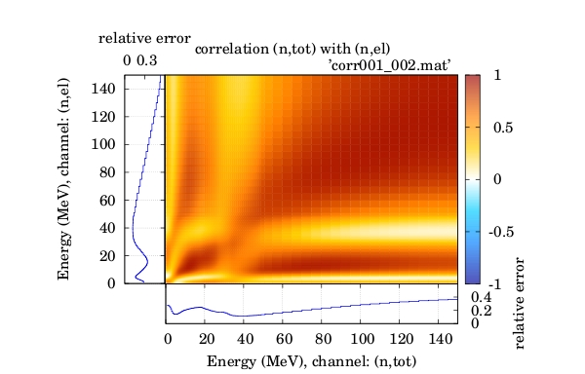
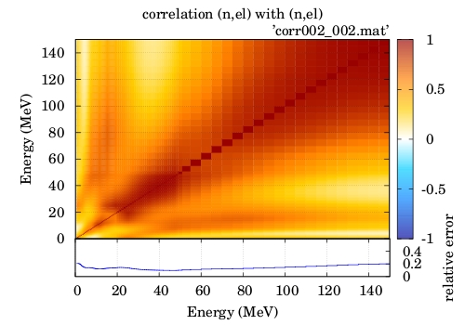
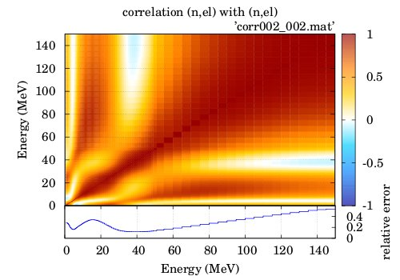
By cross-channel corr. uncertainties of diff. channels than exp. included are reduced.
Cross sections
Prior (n,tot;n,el)
Eval. with full prior
Prior and eval. without prior corr. between channels
Bayesian Parameter Model Experimental
Statistics Uncertainties Defects Uncertainties

Slide 16
The Full Bayesian Evaluation Technique is implemented in the program GENEUS.
GENEUS
GEneral Nuclear data Evaluation and Uncertainty System
Nuclear
Model
Parameter Uncertainties
Model
Defects
Prior cov
Experimental Cross Sections
Linearized
Bayesian
Update
Experiment Covariance Estimation
ENDF
Output
Bayesian Parameter Model Experimental
Statistics Uncertainties Defects Uncertainties

Slide 17
Parameter Uncertainties account for the limited knowledge of the model parameters.
Model deviates from experimental data due to limited knowledge of model parameters, considered in Parameter Uncertainties A₀^{PU}
are calculated by means of Monte Carlo variation of parameters a_{k} within defined boundaries following different distribution functions.
parameter boundaries must be chosen relatively broad to conform to the required complete ignorance of prior knowledge.
Bayesian Parameter Model Experimental
Statistics Uncertainties Defects Uncertainties

Slide 18
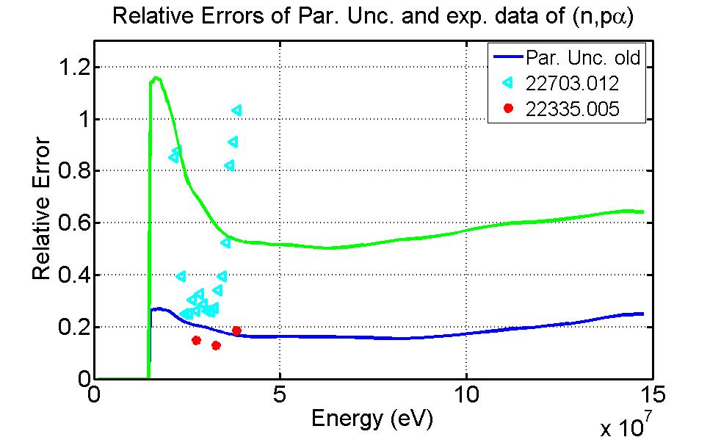
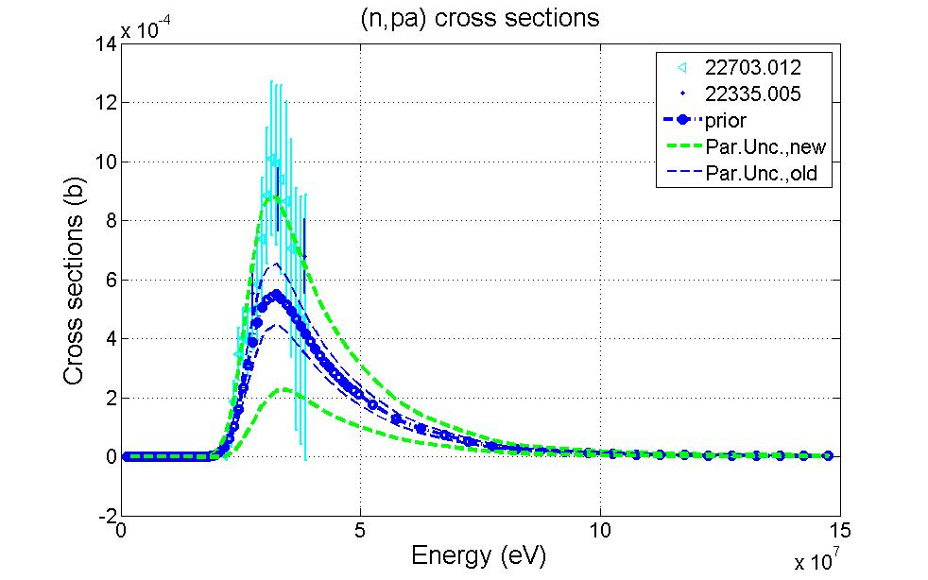
It‘s crucial to chose the right parameter
space for the parameter uncertainties.
(n,pα) xs,⁵⁵Mn
If all important parameters for (n,pα) of ⁵⁵Mn were varied for the Parameter Uncertainties, the prior relative errors corresponded to the experimental ones. The evaluation yields reasonable results.
Bayesian Parameter Model Experimental
Statistics Uncertainties Defects Uncertainties

Slide 19
The Full Bayesian Evaluation Technique is implemented in the program GENEUS.
GENEUS
GEneral Nuclear data Evaluation and Uncertainty System
Nuclear
Model
Parameter Uncertainties
Model
Defects
Prior cov
Experimental Cross Sections
Linearized
Bayesian
Update
Experiment Covariance Estimation
ENDF
Output
Bayesian Parameter Model Experimental
Statistics Uncertainties Defects Uncertainties

Slide 20
Model Defects account for the model deficiencies.
Deficient model cannot reproduce experimental data within its whole parameter space, considered in
Model Defects A₀^{MD}
Constraints:
Uncertainties stemming from model deficiencies must not be described within the model space.
Experimental data which is used in the evaluation must not be used to describe model defects.
Bayesian Parameter Model Experimental
Statistics Uncertainties Defects Uncertainties

Slide 21
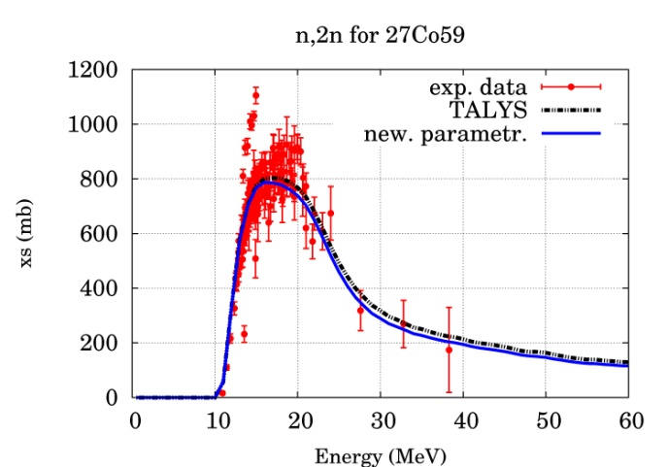
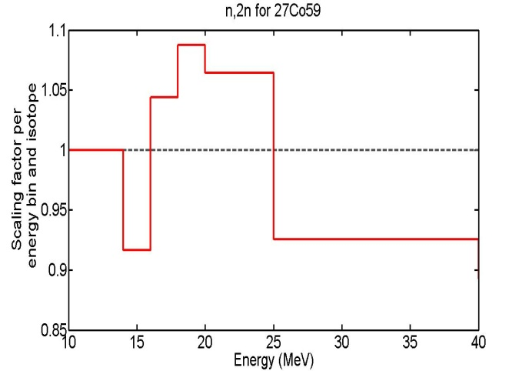
Model Defects are described by means of experimental data of similar isotopes.
The scaling factor for channel c:
Platzhalter, Bild(n2n) anderes Isotop Exp. + Abweichungen
Bayesian Parameter Model Experimental
Statistics Uncertainties Defects Uncertainties

Slide 22
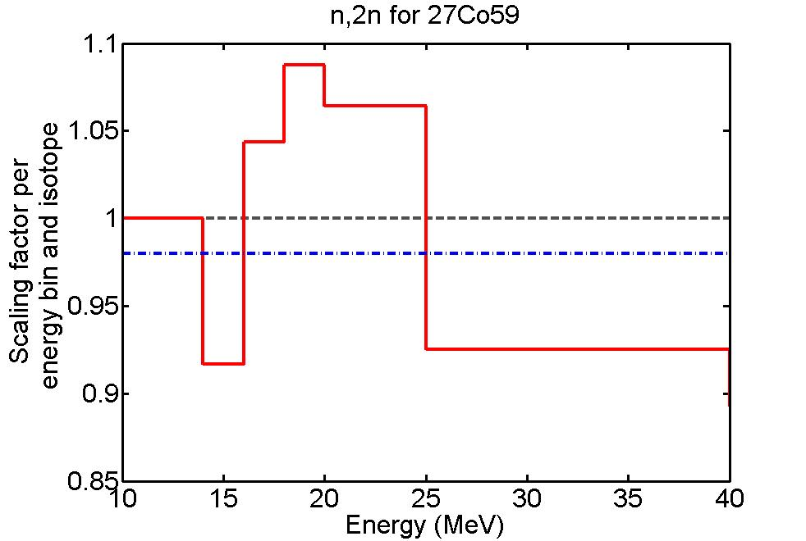
Model Defects are described by means of experimental data of similar isotopes.
The scaling factor for channel c:
Associated uncertainties
Bayesian Parameter Model Experimental
Statistics Uncertainties Defects Uncertainties

Slide 23
Model Defects are described by means of experimental data of similar isotopes.
The scaling factor for channel c:
Associated uncertainties
This procedure works only in energy regions where experimental data are available. Beyond, one needs a suitable extrapolation procedure.
Bayesian Parameter Model Experimental
Statistics Uncertainties Defects Uncertainties

Slide 24
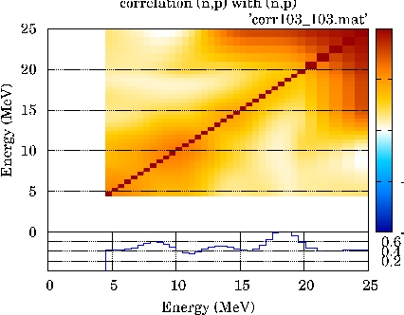
Model Defects are vital in cases where the model deviates largely from the experiments.
Cross sections
Prior
Eval. with full prior
Eval. with parameter unc.
Bayesian Parameter Model Experimental
Statistics Uncertainties Defects Uncertainties

Slide 25
The Full Bayesian Evaluation Technique is implemented in the program GENEUS.
GENEUS
GEneral Nuclear data Evaluation and Uncertainty System
Nuclear
Model
Parameter Uncertainties
Model
Defects
Experimental Cross Sections
Linearized
Bayesian
Update
Experiment Covariance Estimation
ENDF
Output
Bayesian Parameter Model Experimental
Statistics Uncertainties Defects Uncertainties

Slide 26
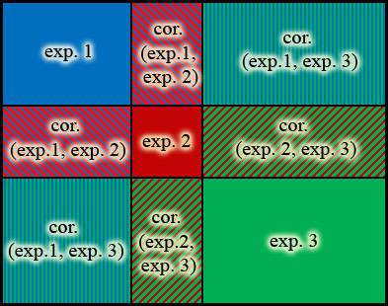
Inter and intra experimental uncertainties are considered.
Three different experimental data sets which deviate systematically from each other, considered in
uncertainties of experiment B
Uncertainties are considered for each individual data set as well as between pairs of data sets.
Bayesian Parameter Model Experimental
Statistics Uncertainties Defects Uncertainties

Slide 27
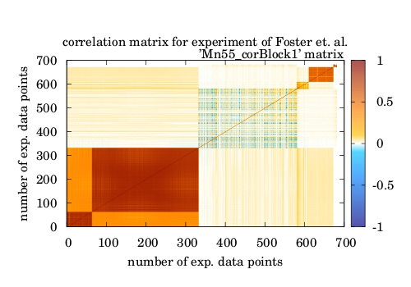
Experimental uncertainties are estimated according to available literature.
Systematic and statistical uncertainties are considered for the single experiments.
Systematic uncertainties are considered as well between different experiments depending on their correlation.
All experiments which are correlated to each other, are part of one large block covariance matrix.
Errors in terms of cross sections energy cross section of standard material
Bayesian Parameter Model Experimental
Statistics Uncertainties Defects Uncertainties

Slide 28
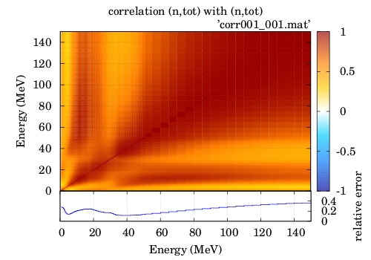
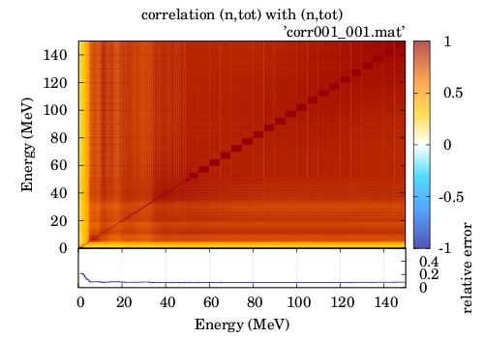
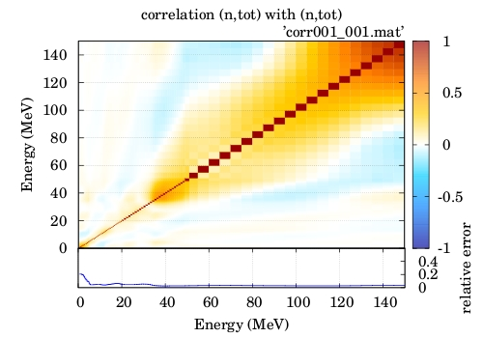
Experimental Uncertainties are propagated by the Full Bayesian Evaluation Technique
Cross sections
Prior
Eval. with full exp. Cov
Eval. with diagonal experimental Cov
Bayesian Parameter Model Experimental
Statistics Uncertainties Defects Uncertainties

Slide 29
New technologies require extension of evaluation energy range and covariances.
Demands of new technologies
To combine exp. and model cross sections σ_{i} consistently up to
150 MeV.
To give associated
uncertainties in form of covariance matrices for whole energy range.
Bayesian Parameter Model Experimental
Statistics Uncertainties Defects Uncertainties

Slide 30
Experimental and theoretical data can be combined consistently IF
the right parameter space is chosen for the Parameter Uncertainties
model deficiencies are considered by Model Defect covariance matrices
uncertainties of experiments are considered in the evaluation
Bayesian Parameter Model Experimental
Statistics Uncertainties Defects Uncertainties

Slide 31
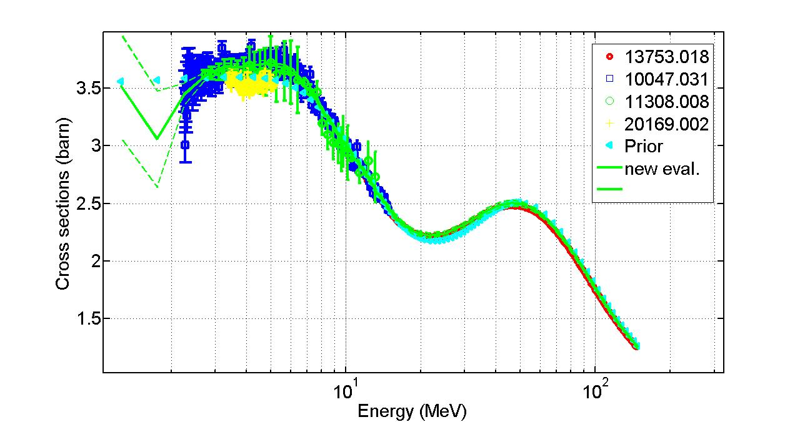
Full Bayesian Evaluation Technique provides consistent σ_{i} and associated uncertainties.
Demands of new technologies
To combine exp. and model cross sections σ_{i} consistently up to
150 MeV.
To give associated
uncertainties in form of covariance matrices for whole energy range.
Bayesian Parameter Model Experimental
Statistics Uncertainties Defects Uncertainties

Slide 32
Plans for the Future
GENEUS
GEneral Nuclear data Evaluation and Uncertainty System
Nuclear
Model
Parameter Uncertainties
Model
Defects
develop and improve deuteron theoretical model
include the fission channel
Experimental Cross Sections
Linearized
Bayesian
Update
Experiment Covariance Estimation
ENDF
Output
Bayesian Parameter Model Experimental
Statistics Uncertainties Defects Uncertainties

Slide 33





The GENEUS-team
Gundacker Leeb Neudecker Srdinko Wildpaner
Stefan Helmut Denise Thomas Volker
Model Defects Parameter Unc. Experiment Est. Parallelization ENDF-Output
Bayesian Updat. (for Par. Unc.)
Thank you for your attention!
Bayesian Parameter Model Experimental
Statistics Uncertainties Defects Uncertainties

